Slide 1

Maine GeoLibrary
Executive Director’s Report
Jay Clark, June 18, 2025

Slide 2

The ESRI contract renewal is out for signature.
The transition to the Cloud is completed with local user support for migrating small data files continuing.
Public users are reaching out and getting support as we can provide it. Engineers and Surveyors are the big group.
We are still having issues with services, and the download/ship capabilities are not working. This needs a new approach.
It is likely that moving forward only small (<= 10 MB) will be directly downloadable and all other requests will be handled based on size through an ecommerce portal.
The Tax Map Training was a great success. About 50 attended, several have reached out for more information and support.
See us next at the Kennebec Council of Governments Planning Day on June 24.
We are building a list of member towns now and we have had our first inquiry about 3” imagery and oblique buy-up.
Bob made an excellent State Map for the State Museum.

Slide 3
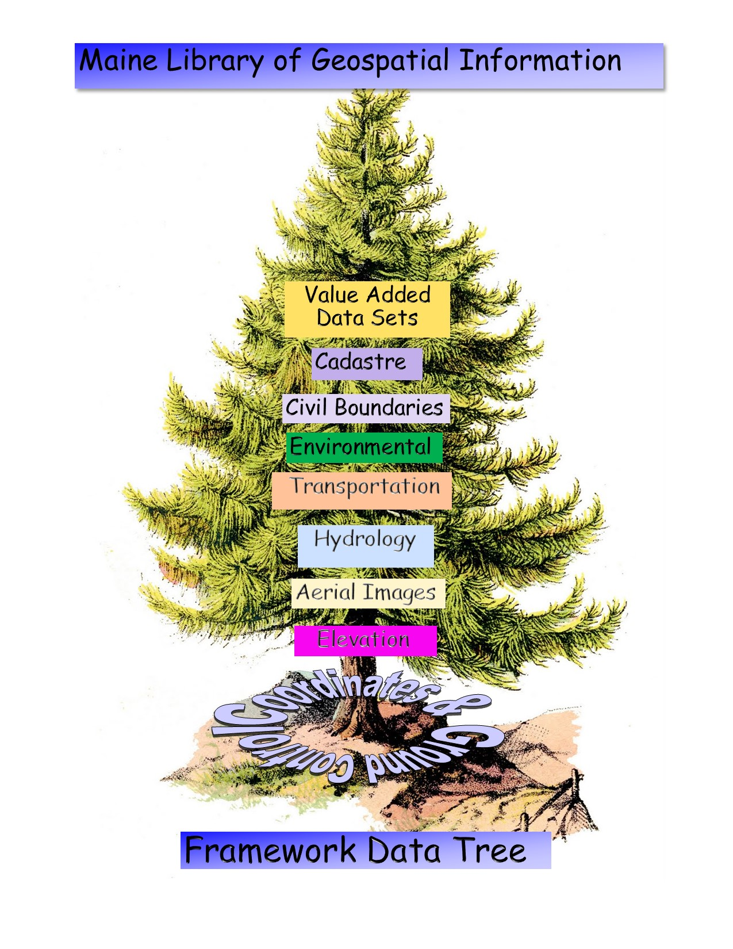

Technical Platform Discussion

Slide 4

The GeoLibrary Technical Profile
Computing and Storage Environment
Public Facing Web Site
Content Assessment (Card Catalog)
Membership (Constant Contact)

Slide 5
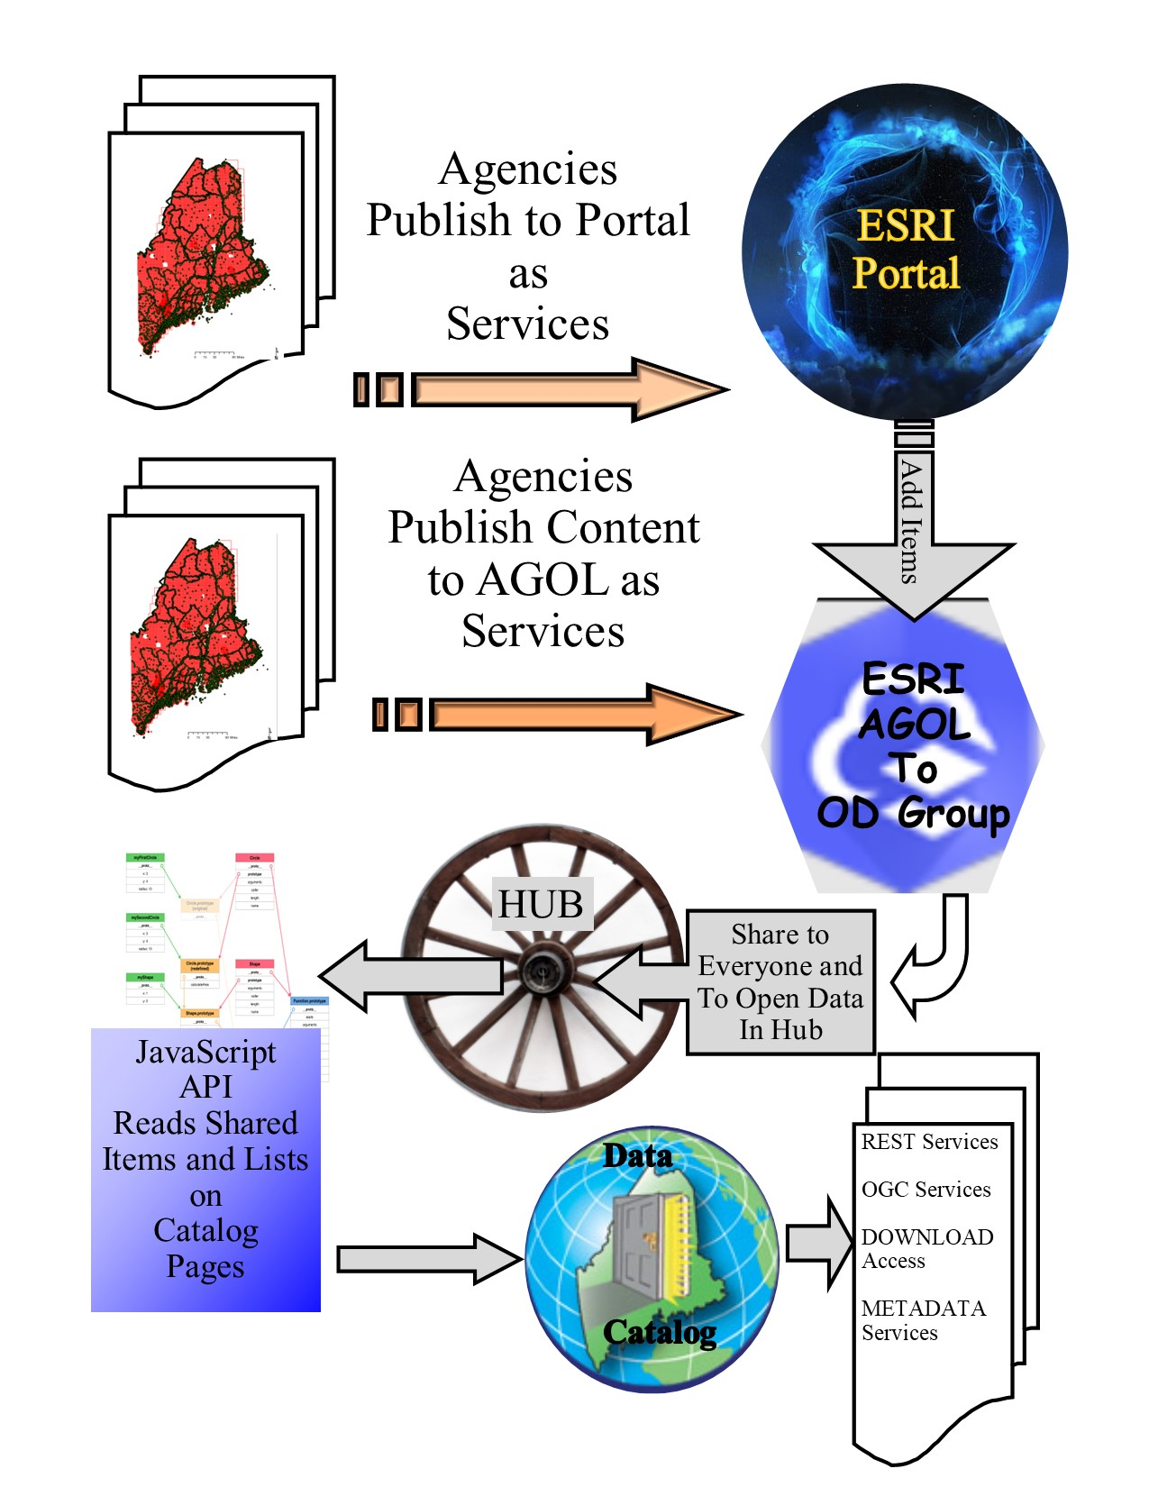
Computing and Storage Environment
ESRI is the software we use for desktop work and distribution/dissemination of working data sets.
We can use the system at several junctures to filter data sets for publication.

Slide 6
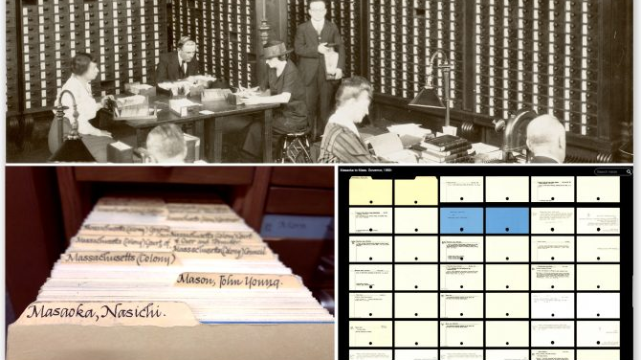
The Card Catalog - Josh Davis

Slide 7
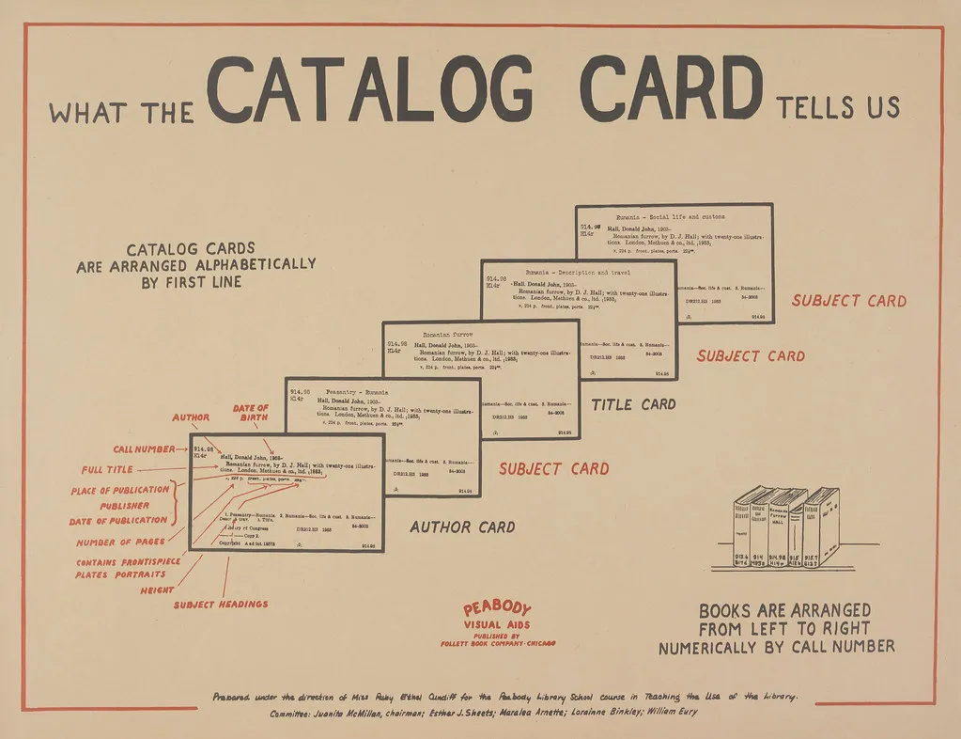
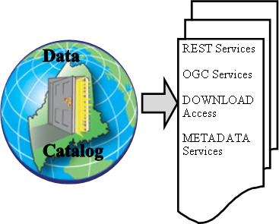
User Services
Content Management
Quality Control
Data & Metadata
Inventory
Queries from ESRI system

Slide 8
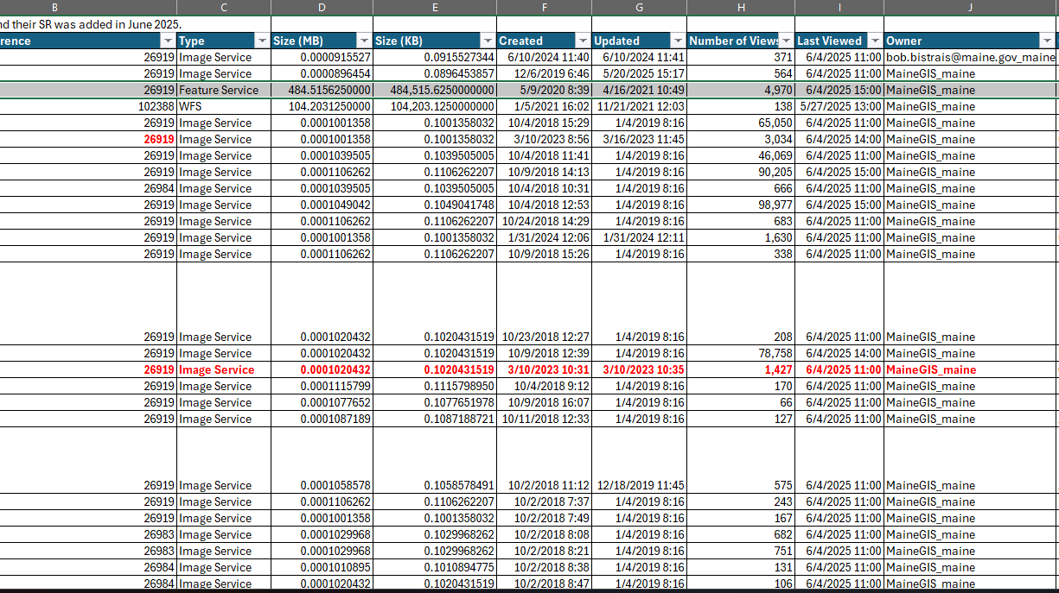
Data Cataloging
Performing quality control checks and comparing to standards
Looking at data structure and metadata
Developing a catalog system for better tracking and management of data
Getting familiar with the data – understanding what is in the GeoLibrary

Slide 9
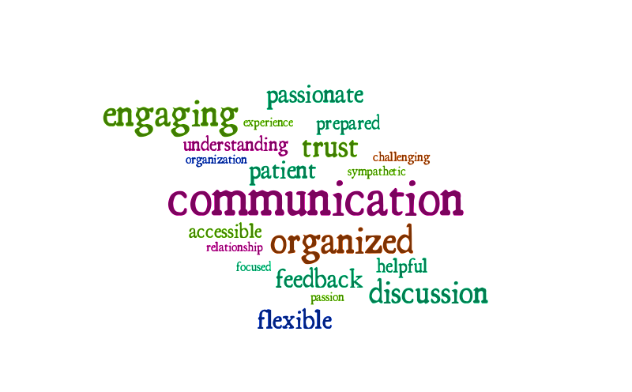
Josh
This Photo by Unknown Author is licensed under CC BY-NC-ND

Slide 10
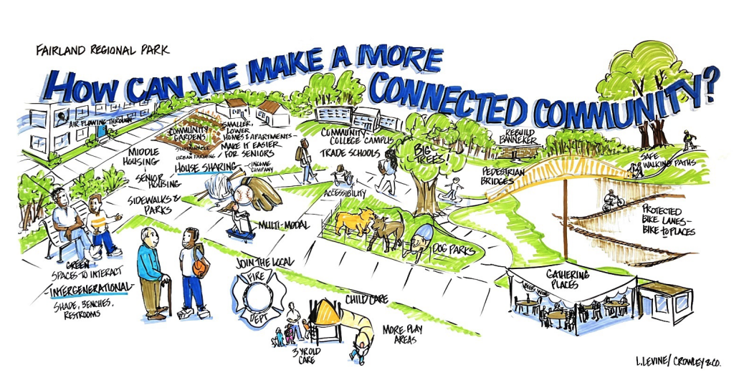
Outreach & Marketing
Claire Lawrence
This Photo by Unknown Author is licensed under CC BY-NC

Slide 11
How Can the GeoLibrary Utilize Marketing?
Members
Support
Users
Educate
Public
Inform
MARKETING
Notes:
When you think about marketing, I would wager that you think about a company advertising a product to sell. This is not the case with the Geolibrary
Anecdote about my first day with the GeoLibrary- went to a trade show and had a town say “what is the catch” our response was collaboration. We don’t want you to take the services and run away with them, we want to use it as a first step to facilitate a cooperative relationship.
So where does marketing fit into this?
-Moving users into membership. Members provide us their emails and will receive monthly email blasts with Geolibrary information, surveys, and the like. This will promote voluntary collaboration and involvement.
Why do we need members?
Know your users- where they need support. Facilitate a cooperative relationship
Three tiers of individuals we market to: Members, Sign-ups, and the Public
Our goal is to move users from the public into membership.

Slide 12
Current State of GeoLibrary Outreach
29K
500+
30
Active GeoLibrary Users in 2024
Existing town contacts
Members already joined*
Notes:
From just one trade show, here’s where we are.
Great start, but that’s exactly what it is: a start. Through a marketing program, we can expand our network of members.
Through marketing strategies, we can create a community of members who share with the GeoLibrary and each other. This will allow us to move further into our distributed knowledge system and gather current, collect, and complete data much more efficiently. This can be applied to any of the framework layers the GeoLibrary is tasked with maintaining. Cooperation will be key.
So how do we do that?

Slide 13
Future in Marketing
After Website stabilization:
Current Outreach Strategies
Email existing connections
Maintaining list of all contacts
Attending conferences
Calling towns
Creating Webinars and additional content
Email Blasts
Surveys
Library Card System
Exclusive Downloads
Notes:
Explain deliverables- both current and after everything is stable

Slide 14
Claire
This Photo by Unknown Author is licensed under CC BY-NC-ND

Slide 15
The Program Plan
Community Data Projects
Technology Projects
Framework Layers
Data Projects

Slide 16
Framework Layers Projects
Framework Layers Get Built.
Coordinates and Ground Control
NEW
Imagery
Services Promoted & New Download Process
Elevation
DEM, DSM, DHM
Need new process for contours
Need to create near and long-term archive for old data.
Need download process.
Add Bathymetry DEM for costal Maine (NOAA).
Data size is unknown. Likely equal to a DEM by area.
Determine the best source (s) for Hydrography and pursue 3DHP project.
NEW
Environmental
Add new Land Cover and Forestry data
NEW
Transportation
DOT Public Map Viewer
NEW
Boundaries Layer US Bureau Of Census And Maine Towns
Cadastre
Towns, Tax Maps, 911 Address Points, and Structures.

Slide 17
Technology Projects
Complete the platform migration assuring stability, expanded data storage, and computing horsepower
Implement a new web site for the GeoLibrary

Slide 18
Hardware and Software Costs
To properly host, serve, and archive these data we need both hardware and software.
We will try to use General Fund monies to acquire hardware and software.
We need to increase our storage. (1 set of high resolution 6” 4-band tiffs = 56 TB)
The Vexcel imagery is still not on-line for local use.
There is bathy data coming which will be equally fat.
There is Land Cover and Forestry raster data on the way.
There is the new statewide DEM to load.
New Software is needed to better support imagery downloads.
New Software is needed to support the Card Catalog and membership system.
A process to price and sort this out could take 6 months.

Slide 19
The Web Site
Meeting with inforME next week to discuss options.
Costs not determined.
MeGIS will support the movement of data through the ESRI system.
Questions remain about the level of content we can support and how that will be delivered.
Web site will use the State of Maine Style template.

Slide 20
Community Projects
Provide an outreach program that effectively communicates the mission and value of the GeoLibrary to the Counties, Cities, and Towns in Maine.
Assure that there is an educational experience available to users of the web site that will aid with inexperienced users and information about the GeoLibrary’s program.

Slide 21
Budget

Slide 22
Claire
This Photo by Unknown Author is licensed under CC BY-NC-ND

Slide 23
Policy Review
A task from the Strategic Plan update is to review and update policies to reflect the current state of technology and best practices.
This will be going on through the next 3 months.
Nate is helping with the Data Policy.
Boad members who are interested in revieing the changes are needed.

Slide 24
Meeting Schedule
June 18, 12:00PM-4:00PM | Planning Meeting | In person and Online
July 16 | OFF
August 20 | OFF
September 17, 1:00PM--3:00PM | Regular Meeting | Online
October 15, 1:00PM-3:00PM | Regular Meeting | Online
November 19, 1:00PM-4:00PM | Year End Review Meeting | In person and Online
December 17, 1:00 PM -4:00PM | Regular Meeting | Online

Slide 25

Happy Summer!
See You on September 17th at 1:00 PM

